Slide 1
OLYMPICS GAMES
ANALYSIS
Prajwal Dubey Soham Sahare Anish Ashtaputre

Slide 2
Introduction
The Olympic Games are the leading international sporting events where athletes from every country are given the opportunity to compete in a wide variety of
disciplines to earn rewards and recognition for themselves and their country. The goal is to analyze how the socioeconomic factors in countries influence that
country’s overall success at the Olympic Games, measured by their medal count.
The analysis will also contain modeling to predict a country’s success in order to
determine the most important socioeconomic factors to success. This analysis can give an understanding as to why some countries dominate events while others are entirely absent from medalling.

Slide 3
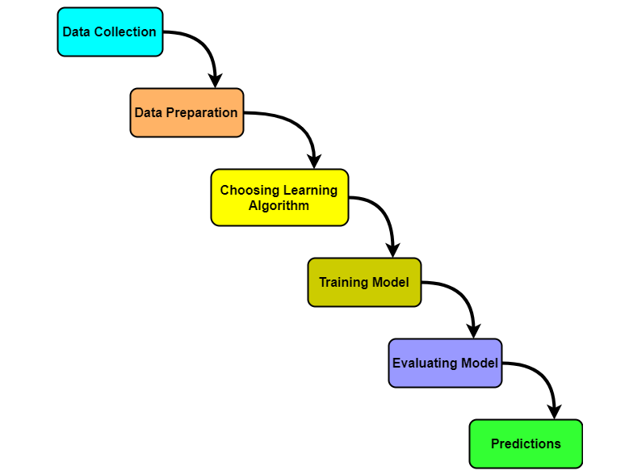
Methodology

Slide 4
Algorithm
1- Random Forest
2 - Decision Tree
3 - Ridge

Slide 5
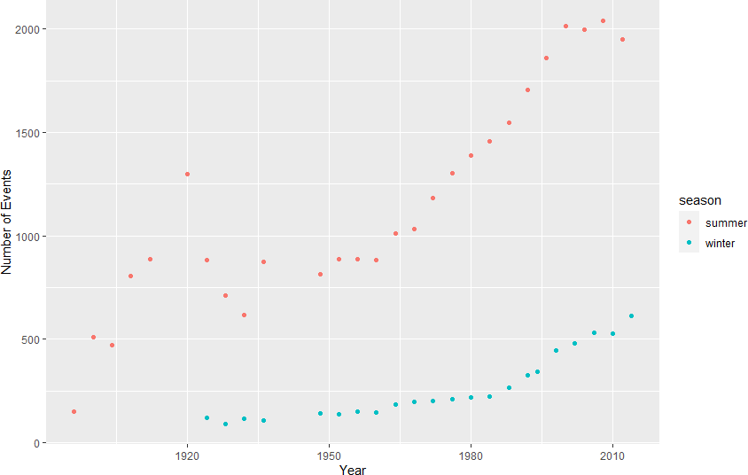
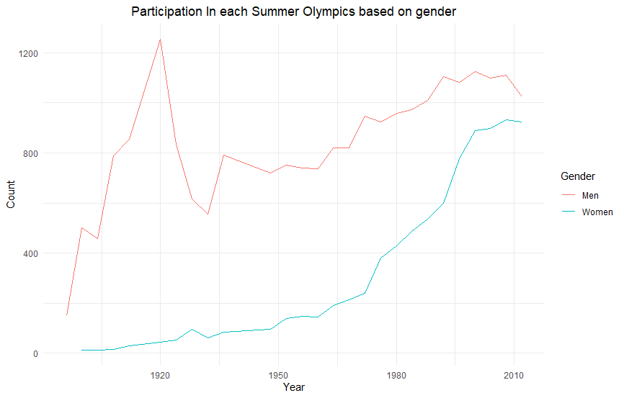
Results

Slide 6
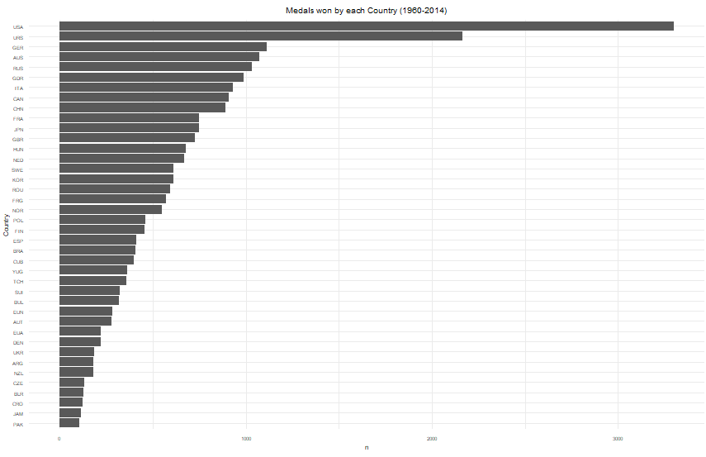
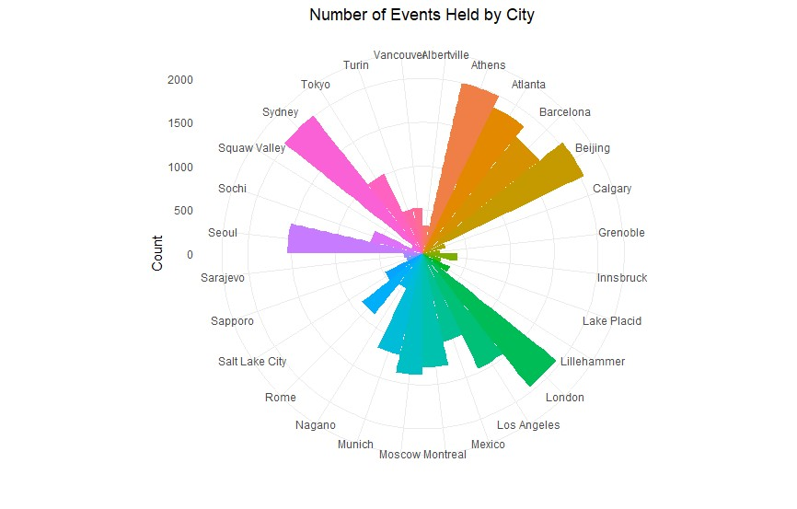
Results

Slide 7
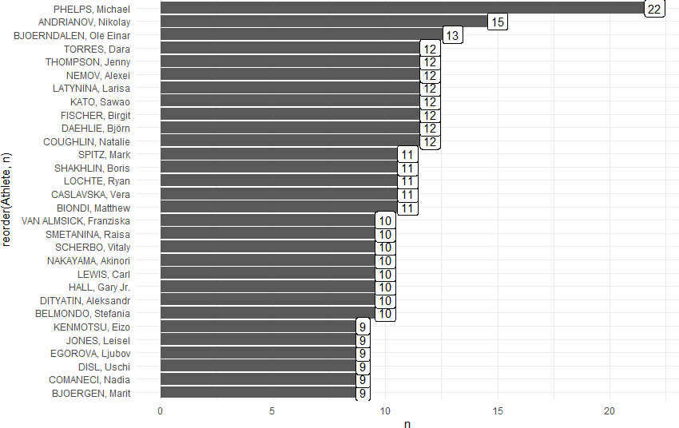
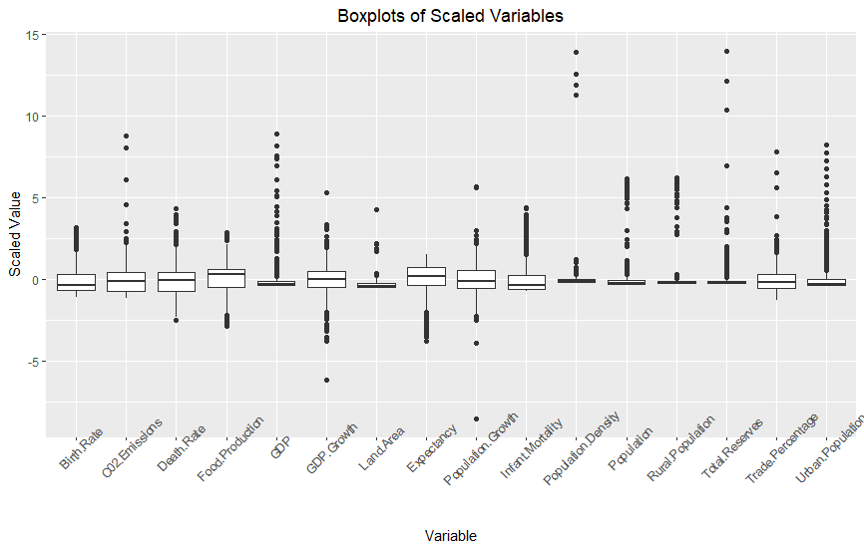
Results

Slide 8
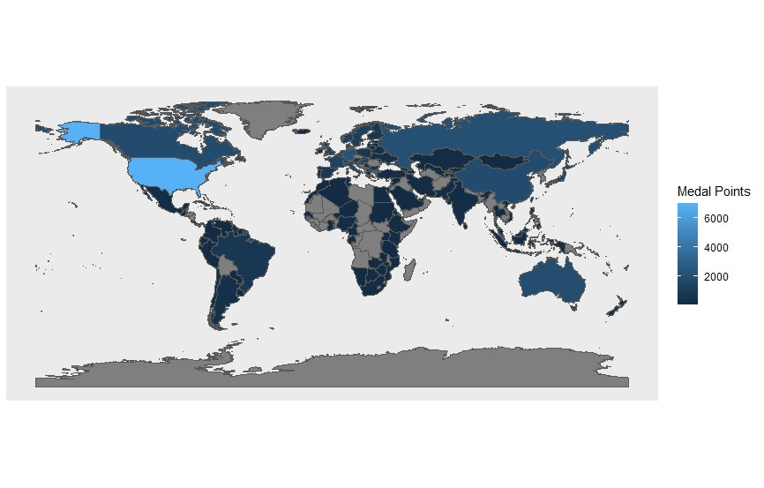
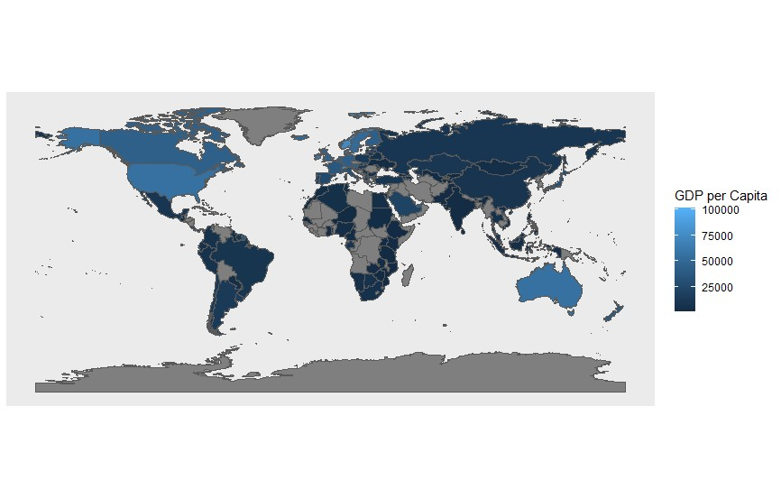
Results

Slide 9
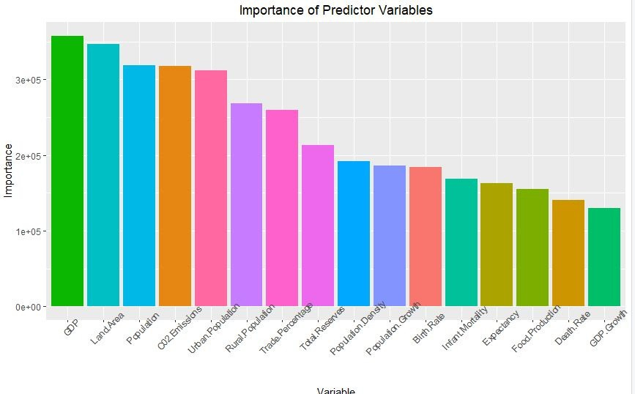
Results

Slide 10
THANK YOU

